Slide 1
The Secret Project:
Money Service Business (MSB)
& Bitcoin Exchange
Banking in Canada
Presented by:
Amber D. Scott
Founder & Chief AML Ninja
Outlier Solutions Inc.
Canadian MSB Association (CMSBA) Fall Conference
October 18, 2017

Slide 2
Hefty Disclaimers
When I stand here today, I stand completely and utterly alone. My opinions are my own… although this time they’re backed by research.
I funded this study on my own; don’t blame anyone else if you’re not happy with the outcome.
I did not ask for permission; don’t assume that it was given.
If your feelings, pride, or reputation are injured by facts, you can have a hug, but I will not remove content to protect the proponents of derisking.

Slide 3

Knowledge Is Power…
Research is what happens when nerds get really angry…
But a boxer who fights angry gets knocked down…
So we funded research, and we’re sharing it.

Slide 4
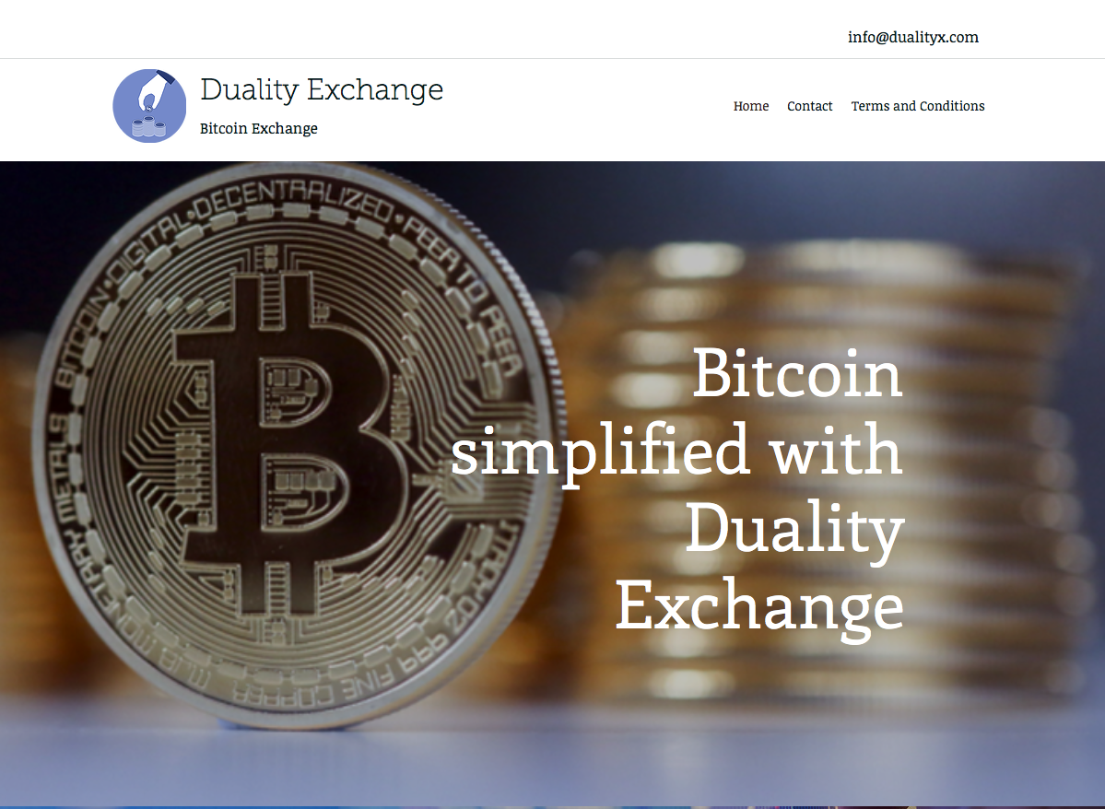
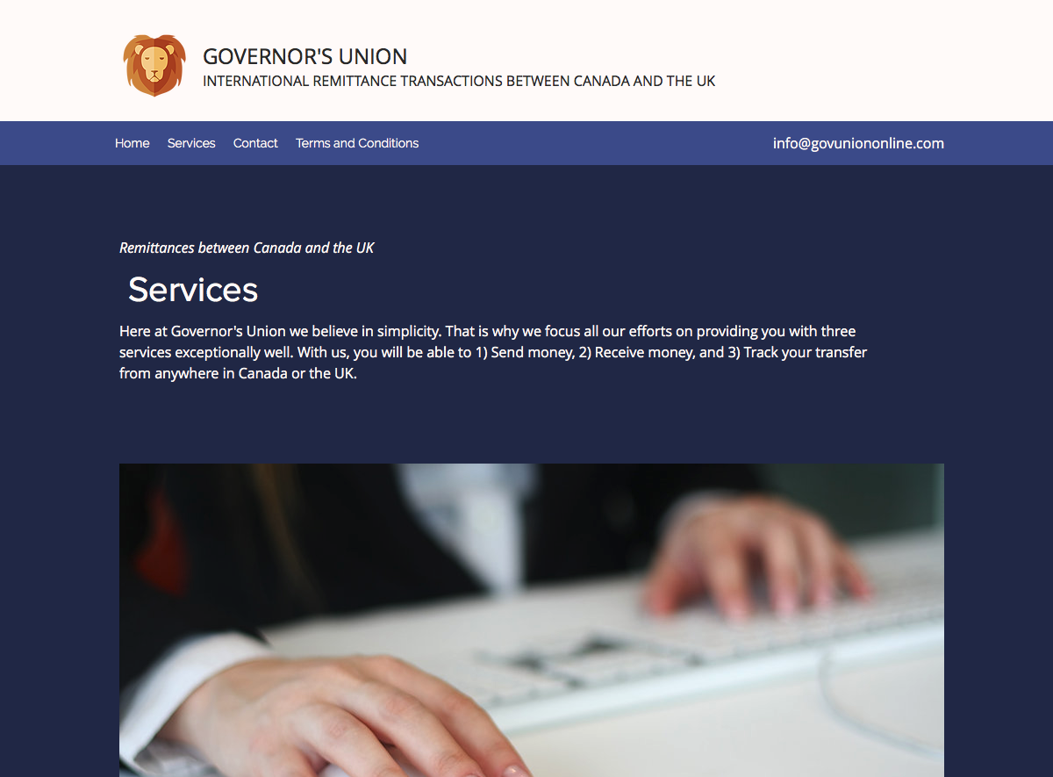
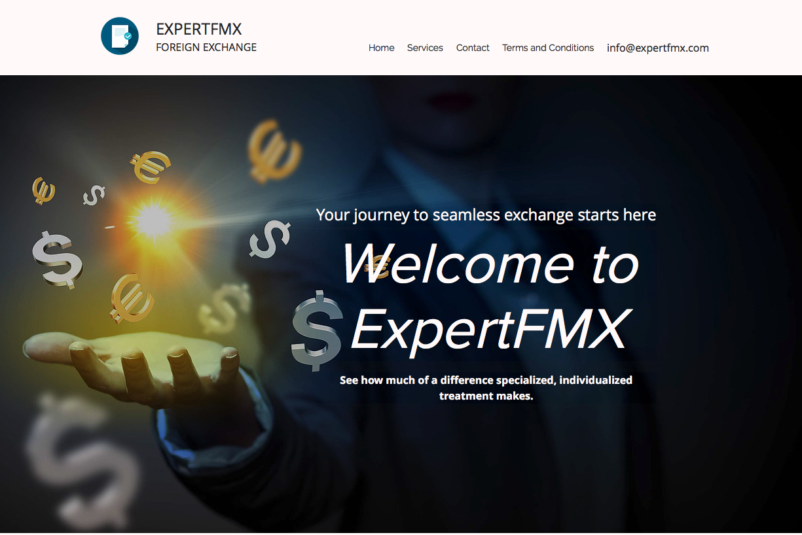
The Method to this Madness

Slide 5
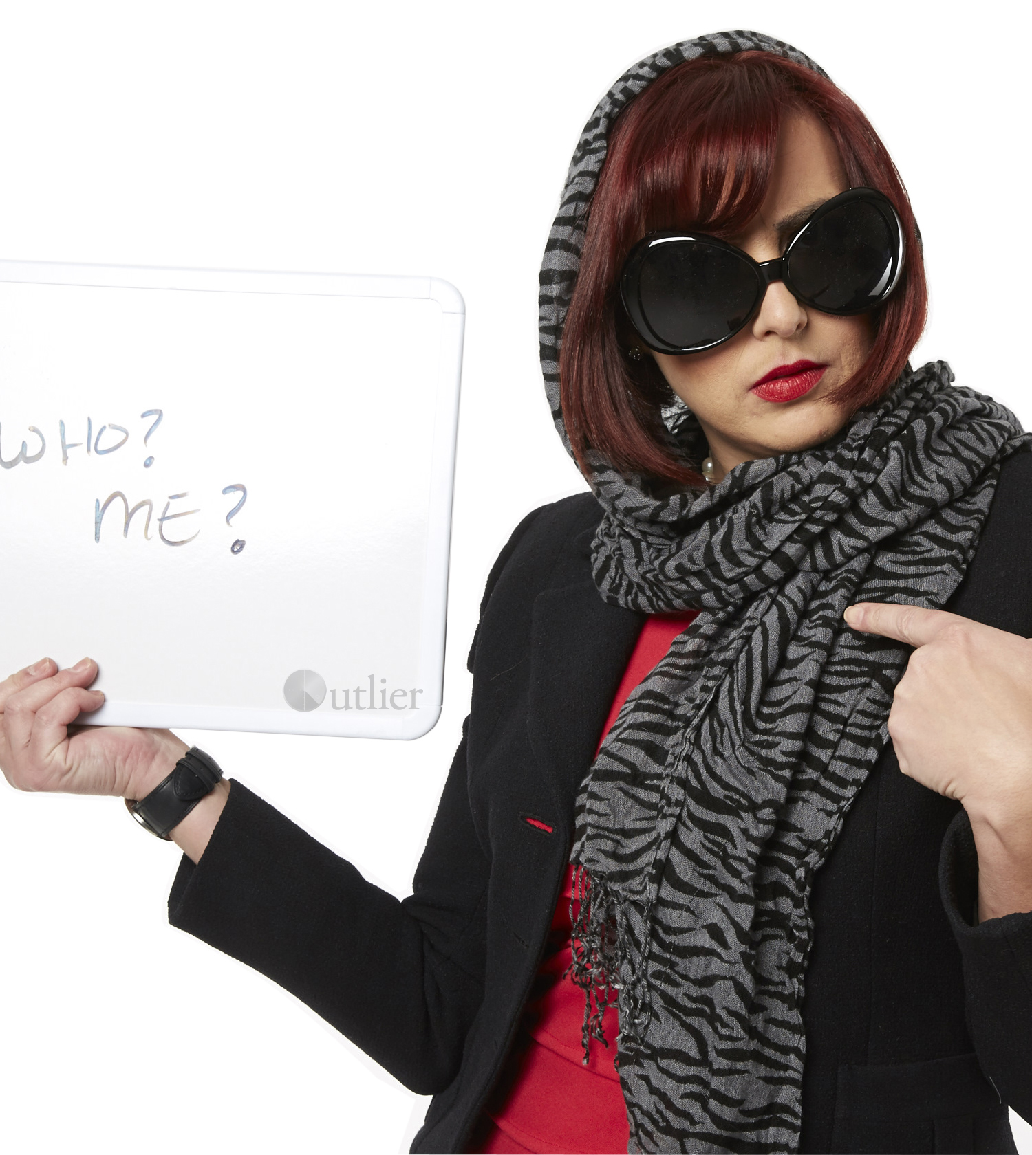
Of Those Who Answered Y/N…
Few said yes…
  Foreign Exchange:
    6/165 (3.64%),
    3 FRFEs, 3 CUs
  Remittance:
    6/138 (4.35%),
    5 FRFEs, 1 CUs
  Bitcoin:
    2/189 (1.06%),
    1 FRFE, 1 CUs
These include “conditional” yes responses
The response rate overall was approximately 48%

Slide 6
Make Noise Like Your Business & Community Depends On It…
The contents of this presentation and the underlying research that it is based on are yours to use, analyze, distribute, etc.
https://drive.google.com/drive/folders/0B97AV38p-RlCNlNrd2NSYXZPbXc?usp=sharing

Slide 7
Contact
Amber D. Scott
amber@outliercanada.com
www.outliercanada.com
(416) 919-1623

